Slide 1
Leeds Beckett University
Cloud Computing Development
Dr Anatoliy Gorbenko
E-mail: A.Gorbenko@leedsbeckett.ac.uk Office: CAE118
Kiran Voderhobli
E-mail: k.voderhobli@leedsbeckett.ac.uk Office: CAE228

Slide 2
Cloud Computing Development
Lecture: Introduction to BigData
Anatoliy Gorbenko
Kiran Voderhobli

Slide 3
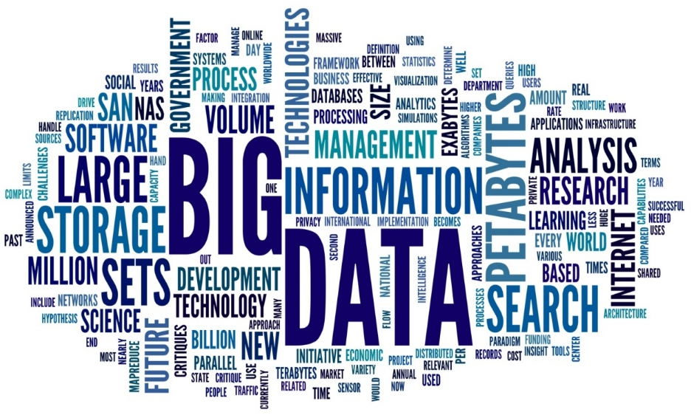
Lecture Agenda
Why now?
What is Big Data?
Social Media Networks
BigData Issues
BigData LifeCycle
Basic Solutions
CAP Theorem
Virtualization

Slide 4
Big Data. Why now?
Explosion of storage needs in large web sites such as Google, Yahoo
Explosion of social media networks (Facebook, Twitter, etc.) with large data needs
Much of the data is not text
Rise of cloud-based solutions such as Amazon S3 (simple storage solution)
Internet of Things and Wearables
Open-source community
Shift to dynamically-typed data with frequent schema changes

Slide 5
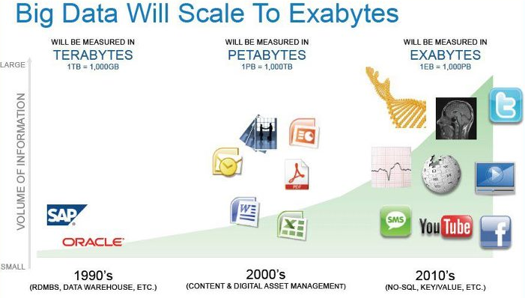
Data Explosion
Big Data Will Scale to Zettabytes
40
ZETTABYTES
2,5
EXABYTES
per day
2020
(IoT, WEARABLES)
(CLOUDS, SOCIAL MEDIA)
http://www.ibmbigdatahub.com/infographic/four-vs-big-data

Slide 6
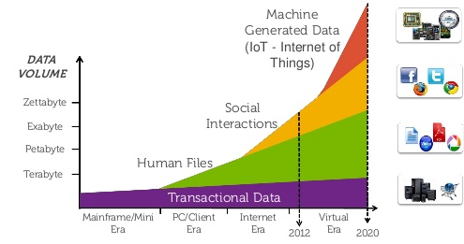
Data Types
http://www.slideshare.net/dellenterprise/dell-solution-tour-copenhagen

Slide 7
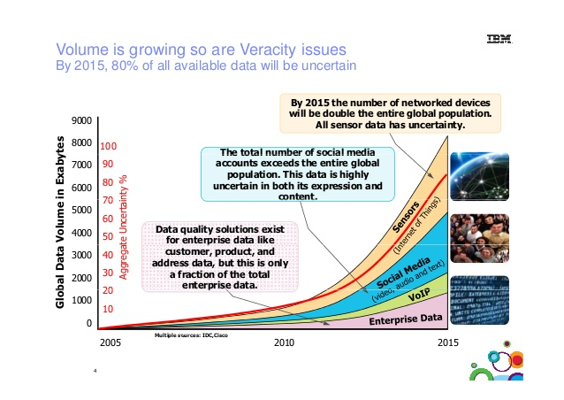
Data Uncertainty
http://www.slideshare.net/prayukth1/big-data-veracity-challenges

Slide 8
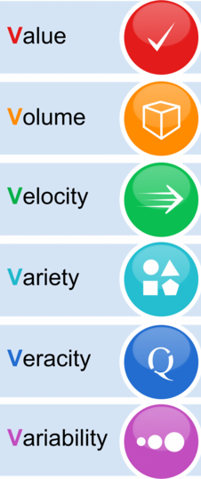
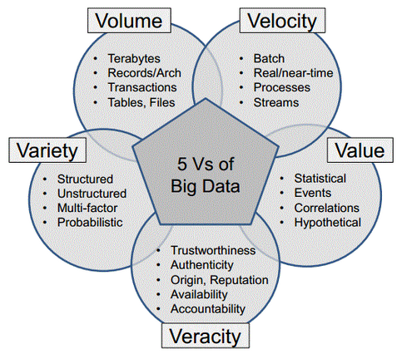
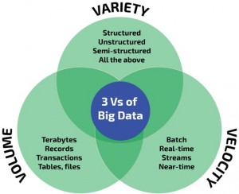
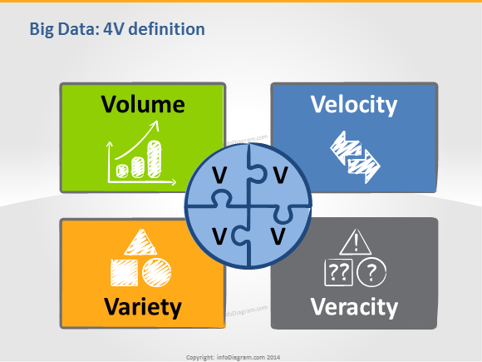
What is ‘Big Data’?
Big data – is information assets that require new forms of processing to enable enhanced decision making, insight discovery and process optimization. (c) Gartner
3-4-5-6V Model of BigData

Slide 9
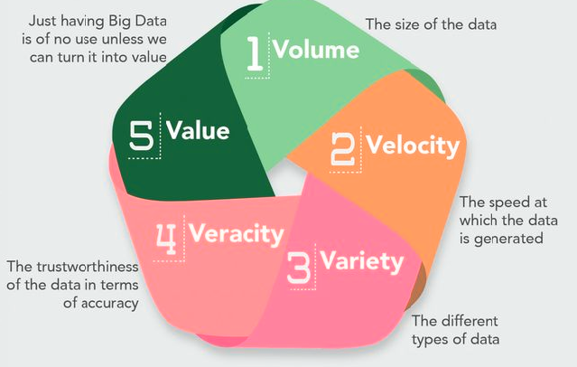
Big Data Properties
Big data is (‘x-V’ model):
high-Volume (amount of data & number of clients),
high-Velocity (speed of data in and out),
high-Variety (range of data types and sources)
high-Veracity (uncertainty of data)
high-Value (data usage)
high-Variability (data evolution, non-deterministic)
…

Slide 10
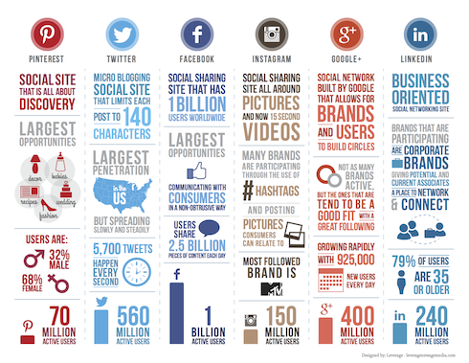
Social Media Networks
Social Media Networks

Slide 11

Big Data: Facebook Example
5 Datacenters;
180000+ servers;
Number of users > 1 billion;
Every day increase ~ 500 TB;
Every year increase ~ 180 PB;
Number of everyday accesses ~ 1 million;
The average person has 5 social media accounts and spends around 1 h and 40 m browsing these networks every day, accounting for 28% of the total time spent on the internet.

Slide 12
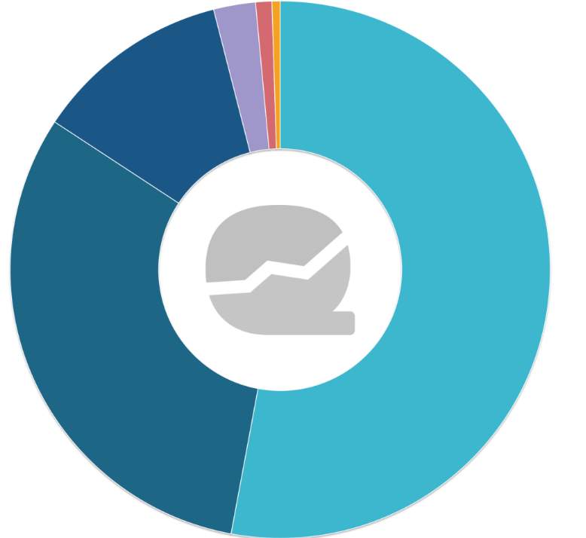

Big Data: Facebook Example
Facebook Post Type Distribution:
Photo – 54%
Link – 30%
Status – 11%
Video – 3%
Cover Photo – 1%
Other – 1%

Slide 13
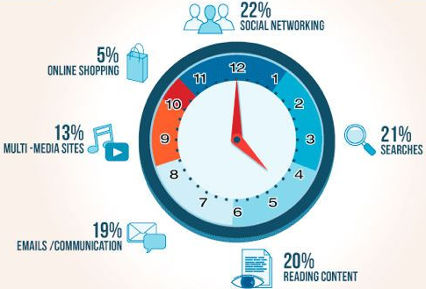
Internet: Social Inclusiveness
How people spend their Internet time
6 hours per day

Slide 14
Why Social Networking?
Personal Devices (smartphones and tablets)
You are never alone
Selfies and twits popularity
Social inclusiveness
social networks addiction
on-line life / social identity schizophrenia
Social authority (no of posts, views, likes, followers, etc.)
Social SEO - accounts promotions (mass-liking, mass-following)
Social networks commerce
Social gaming (Pokemon Go, WoT, etc.)
Monetization
Convergence of Real and Virtual worlds

Slide 15
Big Data. Social and Society Issues
Unconscious privacy violation
Personal digital footprints
Crowd control and manipulation
Work performance degradation
‘Six degrees of separation’ (average path length for social networks of people in Facebook = 3,57)
Active life-span of information and its oblivion
Right of oblivion in social media

Slide 16
Digital footprints: Google example
Check how much Google knows about you
Age, gender, what pages you have viewed, how many times you have visited, how long did you stay etc. http://www.google.com/settings/ads/
location history https://maps.google.com/locationhistory
Google Search history https://www.google.com/history/
YouTube searches https://www.youtube.com/feed/history/search_history

Slide 17
Big Data. Social and Society Issues
Opinion manipulation
Internet forums/Social networks bots and trolls
everything can be proved
proofs are not needed indeed
personalization by social networks causes social isolation and delusion
“Post-truth” politics
by debates appealing to emotions disconnected from the details of policy, and by the repeated false assertions ignoring factual rebuttals
was chosen in 2016 as the Oxford Dictionaries' Word of the Year in the context of Brexit referendum and U.S. presidential election
is driven by false balance in news reporting, and the increasing ubiquity of social media

Slide 18
BigData Issues
Capacity of the single server is limited
Performance of the single server is limited
High availability is crucial
ER data model does not fit Business (OOP) model
Data Security
BigData Management
Data storage media (cache, RAM, SSD, HDD, DVD, type)
Data redundancy (Green?)
Data timeliness (search+access time >> data life time)
Data ageing; who will list up to 100th Google Search page?
Is data correlation a myth?

Slide 19
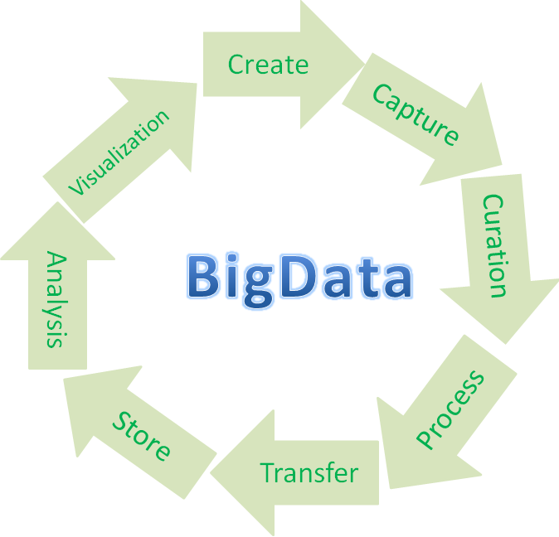
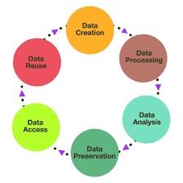
BigData Life Cycle
+
Replicate
Share
Search
Access
Cache
Index
Archive
Delete

Slide 20
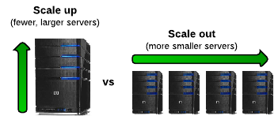
BigData Basic Solutions
Capacity of the single server is limited
=> Scale-Out rather than Scale-Up
=> Data distribution (sharding)
=> ACID is hard to achieve
=> Problems with querying distributed data
Aggregation
Distinctive value
Joins
Sub queries

Slide 21

BigData Basic Solutions
High availability is important
Performance of the single server is limited
=> Data Replication (Fault-Tolerance)
Strong consistency among replicas cause bottleneck
=> Parallel (Distributed) Processing
=> Many data-intensive applications are not CPU demanding that causes bottlenecks in network
=> Code (size is tiny, usually in KBs) is moved to data

Slide 22
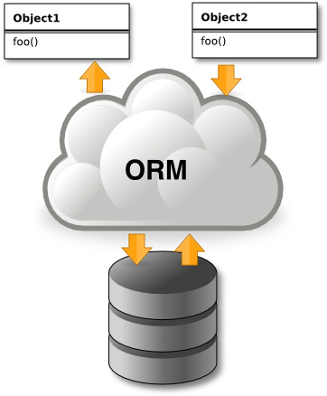
BigData Basic Solutions
ER data model does not fit OOP model
=> Object-Relational Mapping
=> Key/value Storage
=> Schema-less Storage
=> Query language is pore (put/get/del by id)
=> If you want to change query, often you have to change DB structure

Slide 23
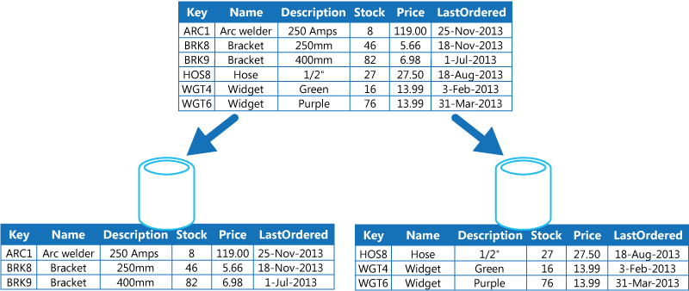
Big Data Partitioning and Access
Data Sharding, i.e. horizontal data partitioning (e.g. hash or range partitioning)
scales well for both reads and writes
not transparent, application needs to be partition-aware

Slide 24
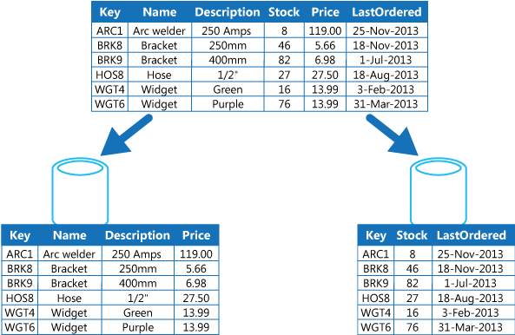
Big Data Partitioning and Access
Vertical Partitioning – reducing the size of the items that are accessed most frequently in the queries performed by the application
the relatively slow-changing data can be separated from the more dynamic data
maximizing the security of sensitive data
slow for JOINs

Slide 25

CAP Theorem
Supposes three properties of a system
Consistency (all copies have same value)
Availability (system can run even if parts have failed)
Partitions (network can break into two or more parts, each with active systems that can not influence other parts)
Eric Brewer’s CAP “Theorem” (1999) : For any system sharing data it is impossible to guarantee simultaneously all of these three properties

Slide 26
CAP Theorem
Traditional RDBMS implement C and A
Very large systems will partition at some point
Node failure (Google reports MTTF=9 hours in its 1800’ node cluster)
Network failure
Network delay

Slide 27
CAP Theorem
To deal with Big Data it is necessary to decide between C and A
Most Web applications choose A (except in specific applications such as order processing)
P depends on timeout settings
C and A are more than just binary
Drop A or C of CAP:
relaxing C makes replication easy, facilitates fault tolerance, speed up transactions
relaxing A reduces (or eliminates) need for distributed concurrency control.

Slide 28
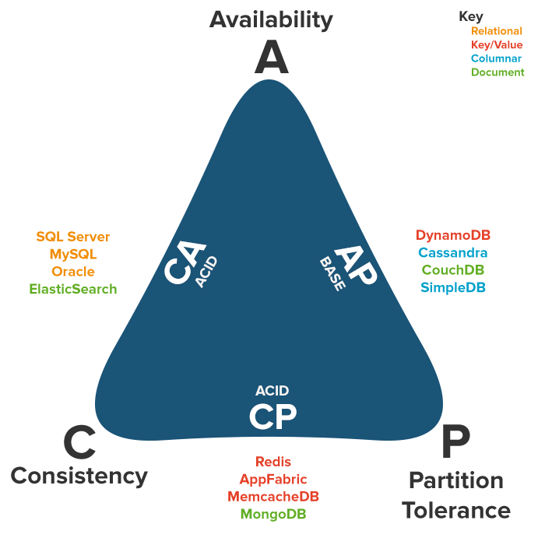
CAP Databases Distribution

